Slide 1






CAIP
Fall Sub-fund Meeting
Tuesday, October 6, 2026
Virtual | 10:00am - 11:30am

Slide 2



WELCOME
Casey Byrne
CAIP Sub-fund Administrator
President, J. Byrne
Jim Ridgway
CAIP Sub-fund Administrator
Vice President, J. Byrne

Slide 3
1.5 QPA Credits:
Continuing
Education
Credits
  1.5 Office Admin / General Duties
Certificates will only release at the end of the program and receipt of Completed Evaluation Form.
Must be present for the entire program.
REMINDER!
1 = GOOD/AGREE
4 = BAD/DISAGREE

Slide 4

NJSIG Update
Joe Semptimphelter
Senior Business Development Specialist
jsemptimphelter@njsig.org

Slide 5


Designed for busy school leaders, LOOR delivers practical, focused professional development in convenient one-hour virtual sessions. Each session includes a ready-to-use Companion Guide, making it easy for principals, supervisors, and department leaders to bring the conversation—and the learning—back to their own teams.
Upcoming Virtual Sessions | 9:30–10:30 a.m.
  September 21: Reporting Obligations for Staff Members
  October 19: Identifying & Reporting Suspected Harassment, Intimidation & Bullying
  November 23: Following Chain of Command
  December 21: Inappropriate Staff Comments
  March 15: Sexual Harassment Explained & Scenario Analysis
  April 19: Staff First Amendment Rights
  May 17: Healthy Workplace Environment Policy

Slide 6
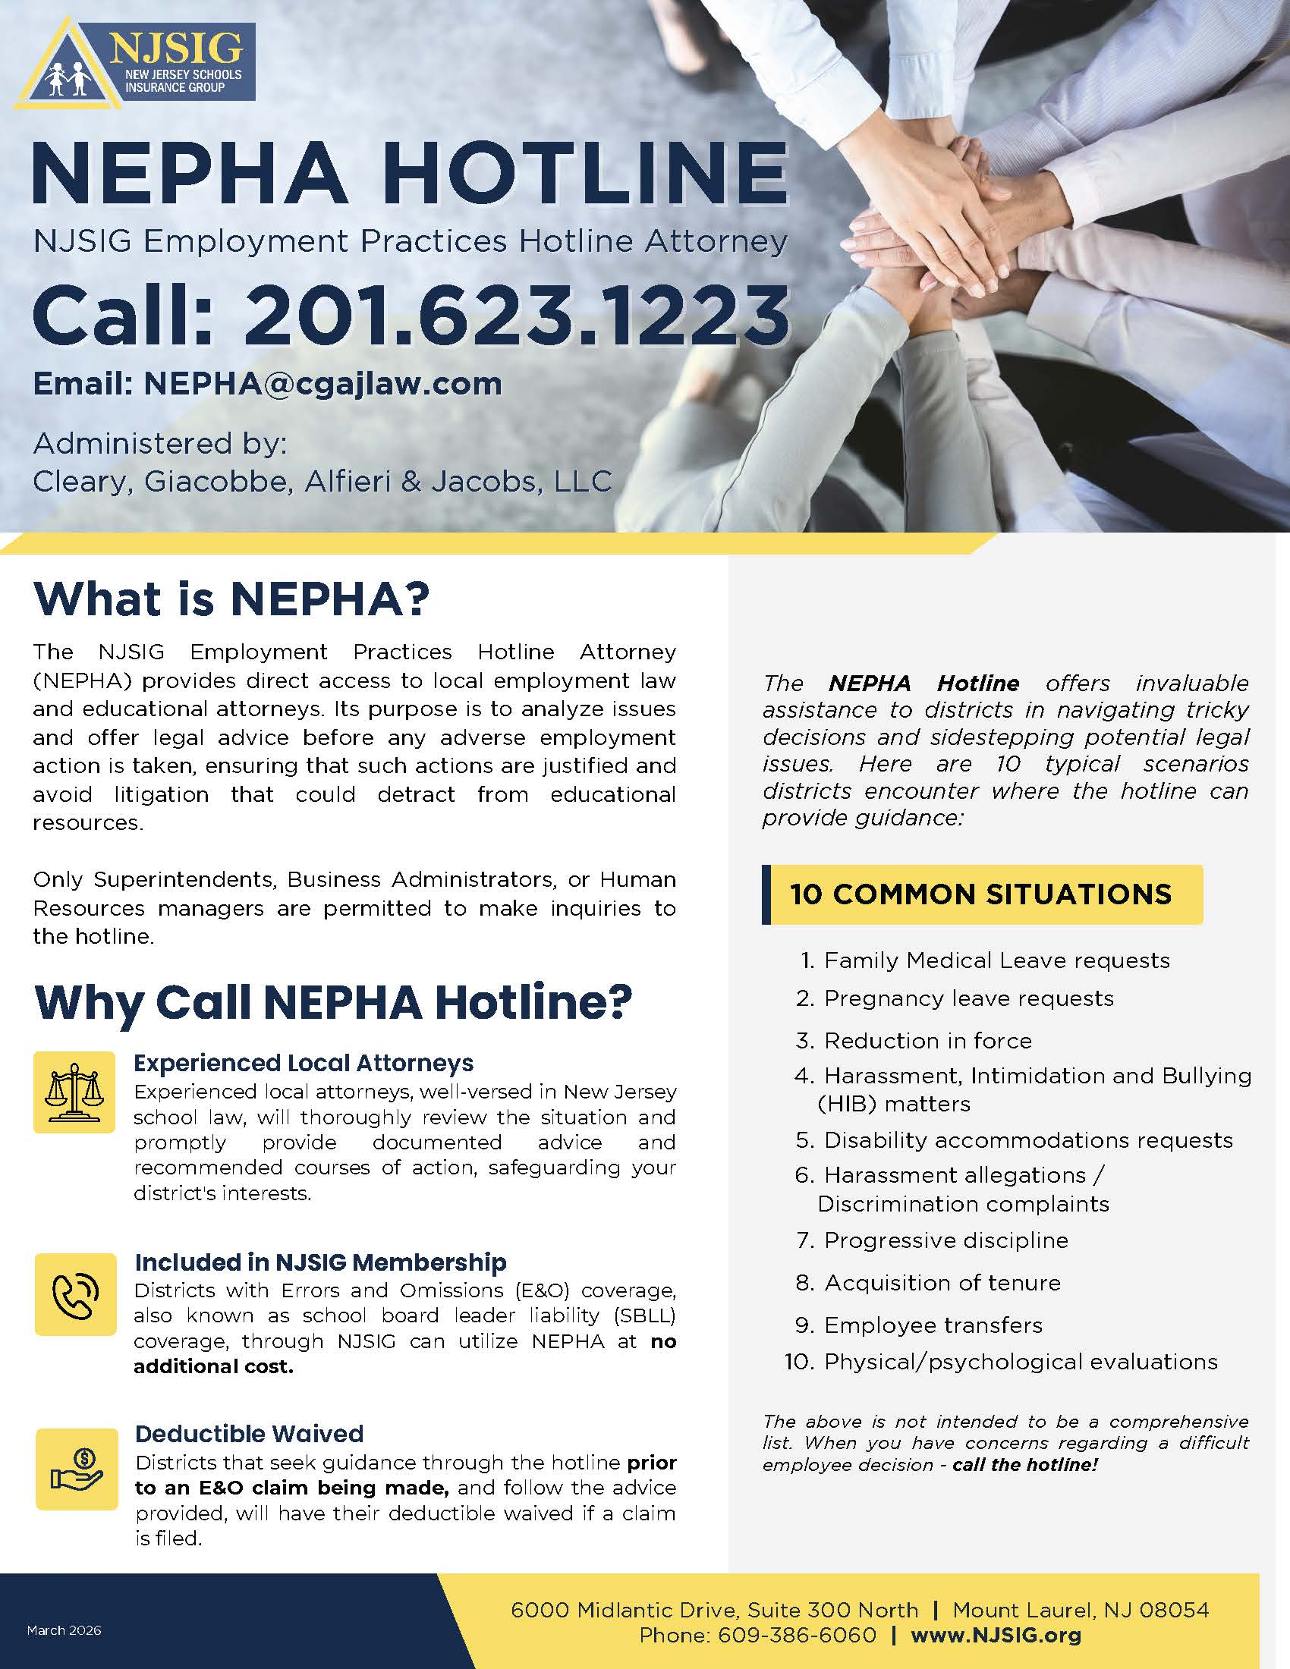
The NEPHA Hotline
NJSIG Employment Practices Hotline Attorney (NEPHA)
Operated by Cleary, Giacobbe, Alfieri and Jacobs
Only a superintendent, BA, or HR manager may make contact
Open to all districts that have errors & omissions (E&O) coverage
Valuable, no-cost resource for expert guidance
Answers to specific employment-related questions
Deductible waived when districts seek hotline guidance before an E&O claim and follow the advice provided.

Slide 7

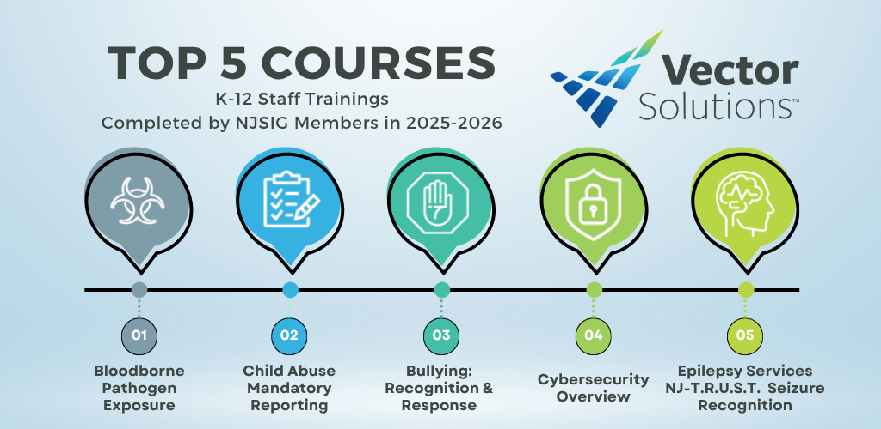
Vector Solutions
Included with NJSIG membership:
100% K-12 school-focused trainings
Library of over 300 courses
Staff completion reports available on demand
Offers many courses required by the New Jersey Department of Education
Quick Reference Guide to assist with assigning trainings

Slide 8

NJSIG @ NJSBA Workshop 2026
NJSIG Presentations
Board Ethics: Risks & Realities Presenters: Sherwin Archibald Rita Barone, Esq. Tuesday, October 20, 2026 9:30am – 10:30am 1:00pm – 2:00pm Room 420 Continuing Education Credits: .5 Board member Academy 1 Qualified Purchasing Agent – Ethics | Navigating Special Education Claims: Pitfalls & Best Practices Presenters: Anthony Fernandez Eric Harrison, Esq. Wednesday, October 21, 2026 11:30am – 12:15pm 2:00pm – 2:45pm Room 313 Learning Lab Continuing Education Credits: .25 Board member Academy

Slide 9

Navigating Leave Requests Under the
FMLA and NJFLA
Presented by: Matthew J. Giacobbe, Esq.
Frances Febres, Esq.
Nicholas DelGaudio, Esq.
CLEARY | GIACOBBE | ALFIERI | JACOBS | lagana LLC

Slide 10
Today’s Topics
Federal Family and Medical Leave Act (“FMLA”)
New Jersey Family Leave Act (“NJFLA”)
Leave as a Reasonable Accommodation
Leave vs. Compensation Entitlements
Designating Maternity Leave
Family Leave Insurance (“FLI”)

Slide 11
Employee Eligibility Under the FMLA
At the time the employee’s FMLA leave will start, the employee must—
  Work for a covered employer;
    Covered employer = private sector employers with >50 employees, all public agencies, and all public and private elementary and secondary schools
  Work at a worksite where the employer employs at least 50 employees within 75 miles;
  Have worked for the employer in total for at least 12 months; and
  During the previous 12 months, have worked at least 1,250 hours
    Hours of service = hours worked: compensable time worked includes activities that are integral and indispensable to the principal activities that an employee is employed to perform.
    Full-time teachers are presumed to meet the 1,250 hours in consideration of time spent outside of the classroom performing job-related duties, and employer thus must be able to clearly demonstrate a teacher did not work 1,250 hours in order to deny leave
      Pay for hours not actually worked do not count (i.e. vacation, sick, personal leave)

Slide 12
Leave Under the Family and Medical Leave Act (FMLA)
Employer must provide eligible employees with—
  Up to 12 workweeks of unpaid medical and family leave during a twelve (12) month period; and
  Up to 26 workweeks of leave during a twelve (12) month period to care for a covered military member with a serious injury or illness
Employee Benefits and Protections
  Continuation of group health benefits under the same conditions as if the employee did not use leave
  Return to work at the same or virtually identical job at the end of the leave period
  Protection from interference and retaliation

Slide 13
Available Leave Under the FMLA
Birth, adoption, or placement for foster and to bond with a newborn or newly-placed child within one year of birth, adoption or placement;
To care for a covered family member with a serious health condition;
  Covered family member = spouse, child, or parent (includes in loco parentis when the employee was a child (no in-laws))
    “child” includes biological, adopted or foster child, stepchild, legal ward, or child of a person standing in loco parentis (in the role of a parent), who is either under age 18, or age 18 or older and incapable of self-care because of a mental or physical disability at the time that FMLA leave is to commence.
  “care” for a family member includes: assistance with basic medical, hygienic, nutritional, safety, transportation needs, physical care, or psychological comfort
To tend to the employee’s own serious health condition.

Slide 14
FMLA: Serious Health Condition
(employee or family member)
An illness, injury, impairment, or physical or mental condition that involves:
incapacity or treatment connected with inpatient care (i.e., an overnight stay) in a hospital, hospice, or residential medical care facility; or a period of incapacity requiring absence of more than three (3) calendar days from work, school, or other regular daily activities that also involves continuing treatment by (or under the supervision of) a health care provider; or
incapacity due to pregnancy, or for prenatal care; or any period of incapacity (or treatment therefore) due to a chronic serious health condition (e.g., asthma, diabetes, epilepsy, etc.); or
incapacity that is permanent or long-term due to a condition for which treatment may not be effective (e.g., Alzheimer's, stroke, terminal diseases, etc.); or,
absences to receive multiple treatments (including any period of recovery therefrom) by, or on referral by, a health care provider for a condition that likely would result in incapacity of more than three consecutive days if left untreated (e.g., chemotherapy, physical therapy, dialysis, etc.).
In the case of “on-the-job” injuries, FMLA and workers’ compensation may run together.
  The reason for the absence must be due to a qualifying serious health condition.
  The employer must properly notify the employee in writing that the leave will be counted as FMLA leave.

Slide 15
Initiation of FMLA Leave
The employee does not need to specifically mention FMLA, but must—
  Provide sufficient information for the employer to recognize leave may be covered by the FMLA
  Once an employee’s leave has been approved for a particular FMLA leave reason, if additional leave is needed for the same reason, the employee must specifically reference the qualifying reason or need for FMLA leave in subsequent requests
Timing
  If the need for FMLA leave is foreseeable → 30 days notice, or if 30 days is not possible or practicable, as soon as practicable
  If the need for FMLA leave is not foreseeable → as soon as practicable

Slide 16
Designation of Leave Notice
Must be in writing and include designation determination, substitution of paid leave information, and fitness for duty information
Must provide the amount of leave that is designated and will be counted against the employee’s leave entitlement, if known
If leave is determined not to be FMLA qualifying, notice may be a simple written statement that the leave does not qualify
Retroactive designation permitted if no harm to employee from failure to timely designate

Slide 17
Use of Paid Leave Benefits During FMLA Leave
Employees may choose or employers may require employees to use accrued paid leave, such as vacation or sick leave, if applicable, at the same time FMLA leave is used
Employees may be eligible to use other benefits while they are using FMLA leave, including—
  Workers’ compensation
  Short-term disability
  Leave provided as an accommodation under the Americans with Disabilities Act (ADA)
  Paid leave mandated under state or local law
Some past practices or collective negotiation agreements may require that accrued leave is first used before FMLA leave is applied.
  See Lumberton Tp. Bd. Of Ed., P.E.R.C. No. 2002-13, 27 NJPER 372, aff’d 28 NJPER 427 (App.Div. 2002)

Slide 18
Leave Certification, Generally
Employer may request certification of serious health condition, qualifying exigency, or serious injury or illness of a covered servicemember
  The Employer must notify the employee of request in writing within 5 days of learning of the FMLA leave need
  Must allow employee at least fifteen (15) calendar days to submit
Employee is responsible for cost associated with obtaining certification

Slide 19
Serious Health Condition Certification
Medical facts appropriate for inclusion will vary
Second and third opinions at employer’s cost
  If the employer has reasons to doubt the validity of the certification, they may require a second opinion
  May require a third opinion by provider agreed to by both employee and employer if the first and second opinions differ
Recertification if need continues for an extended period or if it changes significantly

Slide 20
Incomplete or Insufficient Certification
Employer must give employee written notice and at least 7 calendar days to resubmit
  Incomplete: one or more applicable entries not completed
  Insufficient: information is vague, ambiguous, or non-responsive
Employer, but not the employee’s supervisor, may contact health care provider to authenticate or clarify the certification but may never request additional information from the provider if they have received a complete and sufficient certification.

Slide 21
Fitness for Duty Certification
For an employee’s own serious health condition, employers may require certification that the employee is able to resume work
  Employer must have a uniformly-applied policy or practice of requiring fitness-for-duty certification for all similarly-situated employees
  There is a section in the Designation Form that notifies the employee of the Fitness for Duty requirement.
    Tip: Include the employee’s job description if a fitness for duty evaluation is required.
If collective bargaining agreement is in place, it governs the return to work
Not permitted for intermittent or reduced schedule leave unless reasonable safety concerns exist
Employee responsible for any cost associated with acquiring certification

Slide 22
Counting FMLA Weeks
Employee’s entitlement is 12 weeks of leave in a 12-month period
  Employer’s policy will identify whether the 12-month period is fixed, rolling or starts from the date of the employee’s first use.
Leave Is Counted in Terms of Workweeks
  Ex) An employee who typically works a 5 day, 40-hour week, takes FMLA intermittent leave for 3 days, or 24 hours. The employee has used 3/5 of a workweek of FMLA leave.
Breaks/Holidays Occurring In the Middle of a Consecutive FMLA Leave
  The fact that a holiday may occur within a week taken as FMLA leave has no effect and the entire workweek is counted as a week of FMLA leave.
  BUT if the employer’s activities have ceased for one or more weeks (e.g., school closing for winter or spring recess) the days that the employer’s activities have ceased do not count towards the employee’s FMLA leave entitlement.
School Employees, specifically teachers, may be required to extend their leave if it begins within 5 weeks of the end of the academic term and will last at least 3 weeks, or if the employee would return from leave within the last 3 weeks of the academic term.

Slide 23
Job-Protected Leave
For teachers, if the requested intermittent leave represents more than 20% of their work time, they can be reassigned to an alternative position during the period of leave.
After FMLA leave, employee has the right to return to work in the same job, or one that is nearly the same
  Same duties, responsibilities, status
  Same level of skill, effort, responsibility, and authority
  Identical pay, including premium pay, overtime and bonus opportunities
  Identical benefits, such as life insurance, disability insurance, sick leave, vacation, educational benefits, pensions, etc.
Employees are not entitled to any additional benefits other than those they would have been entitled to if they had not taken FMLA leave

Slide 24
Limitations on Restoration
Employee uses all available FMLA leave and is not able to return to work, though ADA accommodation may apply if employee has a “disability” under the law
Employer denies key employees return to work to prevent substantial and grievous economic injury to operations
  Key employee = highest paid 10% of all employees within 75 miles of the worksite
  Employer must provide key employer notice
Employment changes, such as a layoff or reduced hours, which would have occurred without FMLA leave

Slide 25
Reasonable Accommodation Under the ADA
Leave of Absence as a Reasonable Accommodation
  The ADA may require employers to provide a leave of absence for disabled employees beyond leave entitled under the FMLA as a Reasonable Accommodation.
What qualifies as “reasonable”?
  Indefinite leaves are not reasonable.
  Relaxing time and attendance policies may be reasonable.

Slide 26
Limits to Continuation of Health Insurance Coverage
An employee may choose not to retain group health insurance coverage during FMLA leave
  However, when the employee returns from FMLA leave, the employee is entitled to reinstatement of benefits on the same terms as before the leave
FMLA requirements to continue coverage generally do not apply if an employee is laid off or terminated unrelated to the FMLA, chooses not to return to work for the employer, or is unable to return to work after FMLA ends
  The Consolidated Omnibus Budget Reconciliation Act (COBRA) may require that an employee’s group health coverage continue for a limited period

Slide 27
New Jersey Family Leave Act (NJFLA)
Employers with 15 or more employees and all public employers are required to offer leave under NJFLA.
Employees are eligible if they have worked for the same employer for 3 months or more and have worked 250 or more hours during the preceding 12-month period.
    Up to 90 days of a furlough due to a state of emergency can be counted towards the 3 month employment period.
    The average amount of hours worked per day outside of the furlough period is used in determining whether the 250 hours are met.
    To assess hours worked, employ a similar analysis to the FMLA. Namely, calculate the amount of hours for which an employee receives compensation (includes overtime and worker’s compensation)
      HOWEVER, employers have the discretion to determine whether compensation for accrued leave (vacation, sick, personal) count towards the 250 hours.

Slide 28
Circumstances for Leave and How Much Leave is Available
Caring for a family member with a serious health condition;
Caring for a child within one year of birth;
Bonding with a newly adopted child or foster care placement; or
To provide required care or treatment for a child during a state of emergency if their school or place of care is closed by order of a public official due to an epidemic or other public health emergency
**NOTE: Employee’s own serious illness is not covered.**
Each eligible employee may take up to 12 weeks of leave in a single block of time, intermittently, or by reducing their normal schedule for no more than 24 consecutive weeks in a 24-month period.
  Similar to the FMLA, 12 weeks are applied on a fixed, rolling or anniversary basis.

Slide 29
New Jersey Family Leave Act (NJFLA) (cont.)
The employee’s health benefits will remain protected while on leave.
NJFLA is not paid leave by the employer. However, an employer’s policy may provide that an employee may be required to or may choose to use accrued paid leave, concurrently with some or all of their NJFLA leave.
NJFLA leave can be paid through the State’s Family Leave Insurance program if employees are eligible under the state’s requirements.
  Employee may apply for benefits when on approved unpaid leave of absence to care for family member with a “serious health condition” and/or to bond with newborn
  No “double dipping”
  If employee applies for FLI, employer cannot force the use of accrued time during the leave (but can supplement leave)
  Eligible workers will receive 85% of their average weekly wage, up to a maximum benefit rate set for that year (example: in 2026, the maximum weekly benefit is $1,119).
  Employees must provide employers with 15 to 30 days advance notice depending on the basis for leave.

Slide 30
Employee Entitlement Upon Return to Work
The employee is generally entitled to the same position held before the leave.
  Exception: If the original position is no longer available when the employee returns, the employer must offer an equivalent position in terms of pay, benefits, and status.
  Layoff: If a layoff occurred while the employee was on leave, the employee retains the same rights as if no leave had been taken.

Slide 31
NJFLA vs. FMLA
NJFLA can be used every 24 months; FMLA can be used every 12.
15 employee threshold for NJFLA; 50 employee threshold under FMLA
Employed for 3 mos. for NJFLA leave; compared to 12 mos. for FMLA leave
250 hours vs. 1,250 hours
NJFLA is mandated by the State; FMLA is mandated by federal law.
NJFLA used for others; FMLA used for self (and others).
NJFLA covers caring for more distant relatives, such as parent-in-laws, grandparents, grandchildren, siblings, domestic partners, anyone related by blood who is considered a family member, and any other individual that the employee shows to have a close association with the employee which is the equivalent of a family relationship. FMLA covers care for child, spouse or parent.

Slide 32

Leave taken for the same “qualifying reason”
shall be concurrently designated as FMLA & NJFLA
But… N.J.A.C. 13:14-1.6(b)(2):
“If an employee takes FMLA leave… because of their own disability, including a disability related to pregnancy or childbirth, and…a child is born or adopted while he or she is still on FMLA disability leave, the intervening birth, adoption or serious family illness does not convert the FMLA leave…to a leave under the [NJFLA]. for as long as the employee continues to be eligible for FMLA leave based on their own disability the leave does not simultaneously count against the employee’s entitlement under the [NJFLA[]…”
Pregnancy- and/or
childbirth-related
disabilities
N.J.A.C. 13:14-1.6(a):
“Where an employee requests leave for a reason covered by both the [NJFLA] and another law, the leave simultaneously counts against the employee's entitlement under both laws.”
29 C.F.R. § 825.701(a):
“If leave qualifies for FMLA leave and leave under State law, the leave used counts against the employee's entitlement under both laws”.
Bond with newly-born child
Care for family member
Qualifying exigency
FMLA & NJFLA
leave
FMLA leave
only

Slide 33
Designating Maternity Leave
If your district runs sick leave & FMLA concurrently -
Due Date/
Delivery Date
Disability Period Ends
Pregnancy-related
Disability
(4 weeks)
Childbirth-related
Disability
(6 weeks)
Bond with newly-born child
(12 weeks)
Paid Sick Leave
(10 weeks)
FMLA Leave (10 weeks)
FMLA Leave (2 weeks)
NJFLA Leave (12 weeks)

Slide 34
Designating Maternity Leave
If your district runs sick leave & FMLA consecutively and employee
has insufficient sick leave for entire disability period
Due Date/
Delivery Date
Disability Period Ends
Pregnancy-related
Disability
(4 weeks)
Childbirth-related
Disability
(6 weeks)
Bond with newly-born child
(12 weeks)
Paid Sick Leave
(7 weeks)
FMLA Leave
(3 weeks)
FMLA Leave (9 weeks)
NJFLA Leave (12 weeks)

Slide 35
Designating Maternity Leave
If your district runs sick leave & FMLA consecutively and employee has sufficient sick leave for entire disability period
Due Date/
Delivery Date
Disability Period Ends
Pregnancy-related
Disability
(4 weeks)
Childbirth-related
Disability
(6 weeks)
Bond with newly-born child
(12 weeks)
Paid Sick Leave
(10 weeks)
FMLA Leave (12 weeks)
NJFLA Leave (12 weeks)

Slide 36
Questions?

